Slide 1
Annual Time-Series Analysis with GridLAB-D

Slide 2
Time-series Simulations
A power flow solution is for a single point in time.
Time series simulations are necessary for analysis other than “peak capacity” planning.
Time-series simulations are a series of power flow solutions.
This is not the same as transmission level dynamic or electromagnetic simulations.
These simulations are significantly more complicated and can generate an enormous amount of data.

Slide 3
Time-series Simulations
State (x)
Δx
Δt
Time (t)

Slide 4
Time-series Simulations cont.
Daily cycles: 24 hours
Weekly Cycles: Weekday vs. Weekend
Seasonal Cycles: Fall, Winter, Spring, Summer

Slide 5
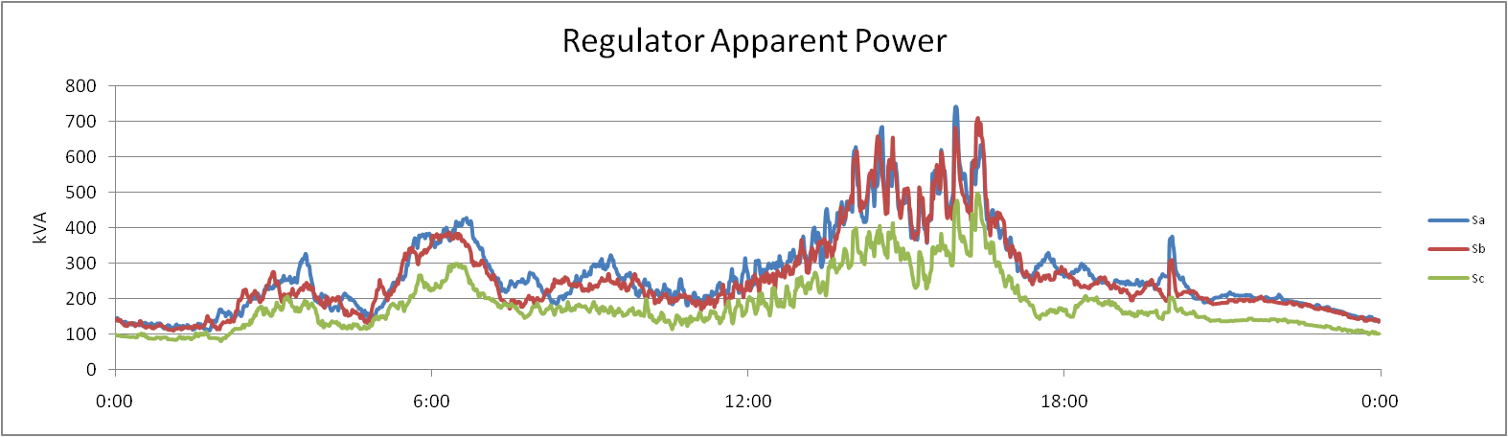
Daily Cycles
Within a given day there is a diurnal cycle, which reflects the behavior of the end users.
It is common to have a peak load in the morning or the afternoon or a combination of both.

Slide 6
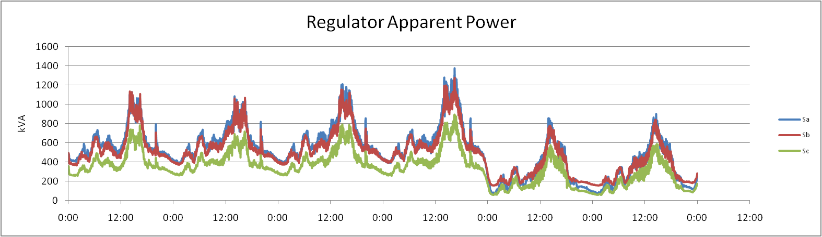
Weekly Cycles
The consumption of energy varies between weekdays and weekends.
This is true of residential, commercial, and industrial loads.

Slide 7
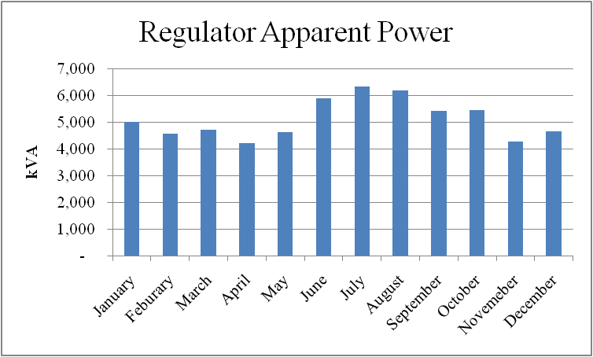
Seasonal Cycles
Based on the climate of a region there can be significant changes in energy consumption over the course of the year.
Overall energy consumption as well as peak load will vary.

Slide 8
Desired Information
Voltage profiles
  Regulated voltage (recorder)
  Voltage drop (recorder)
Load
  Feeder level (recorder)
  Sum of residential (collector)
  Sum of commercial (collector)
Losses
  Overhead (collector)
  Underground (collector)
  Triplex (collector)
  Transformer (collector)
Statistical
  Transactive market signal(s) (recorder)
  HVAC units (collector)
  Hot water heaters (collector)

Slide 9
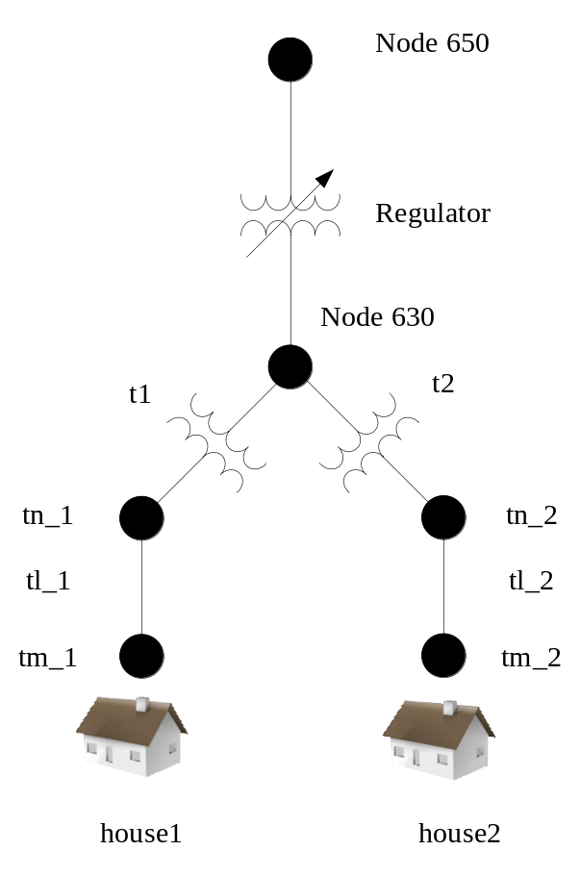
Simple System
House 1 is on phase A while house 2 is on phase B.
Suitable for comparing the behavioral differences between 2 houses.
Even with such a small system there can be an enormous amount of output data.

Slide 10
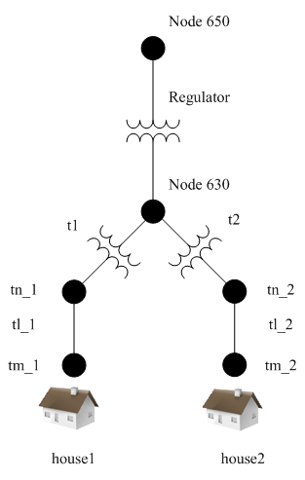
Simple System cont.
Very small system which focuses on the secondary distribution and residential components.
Simulation for 1 year takes 30 minutes using the FBS solver., over 50 with recorders.
This is 525,600 time steps each of which require a power flow solution.
Each object has a solution for each of the 525,600 time steps
Excel will only plot 32,000 lines.

Slide 11
Simple System Outputs
Market Values: 24 hour average, 24 hour standard deviation, current market clearing price.
Regulator Output: tap positions as well as real and reactive power outputs.
House 1 meter V: 120 and 240 nominal voltages.
House 2 meter V: 120 and 240 nominal voltages.

Slide 12
Exercise 1
Add recorders and collectors as necessary to the Simple System. Run the simulation for 1 year.
Plot the voltages as seen at each of the houses.
What issues, if any, exists with regard to the two houses?

Slide 13
Exercise 2
Skew house 2 by -45 minutes.
Run the simulation for 1 year.
Plot the voltages as seen at each of the houses.

Slide 14
What Happens When a Simulation is Too Long to Run?
For a large distribution feeder with 2,000 residential homes the simulation time start to slow significantly.
Normally this is not an issue, but if annual simulations are performed it must be addressed.
At 60 times real time an annual simulation will take nearly 1 week.

Slide 15
What Happens When a Simulation is Too Long to Run?
Simulations can be broken into multiple parts.
  By week (52 simulations = 1 year)
  By month (12 simulations = 1 year)
Each part must be the exact same file with continuous schedules.
When a simulation is broken into multiple parts the thermal history of the loads is lost at these points.

